Slide 1
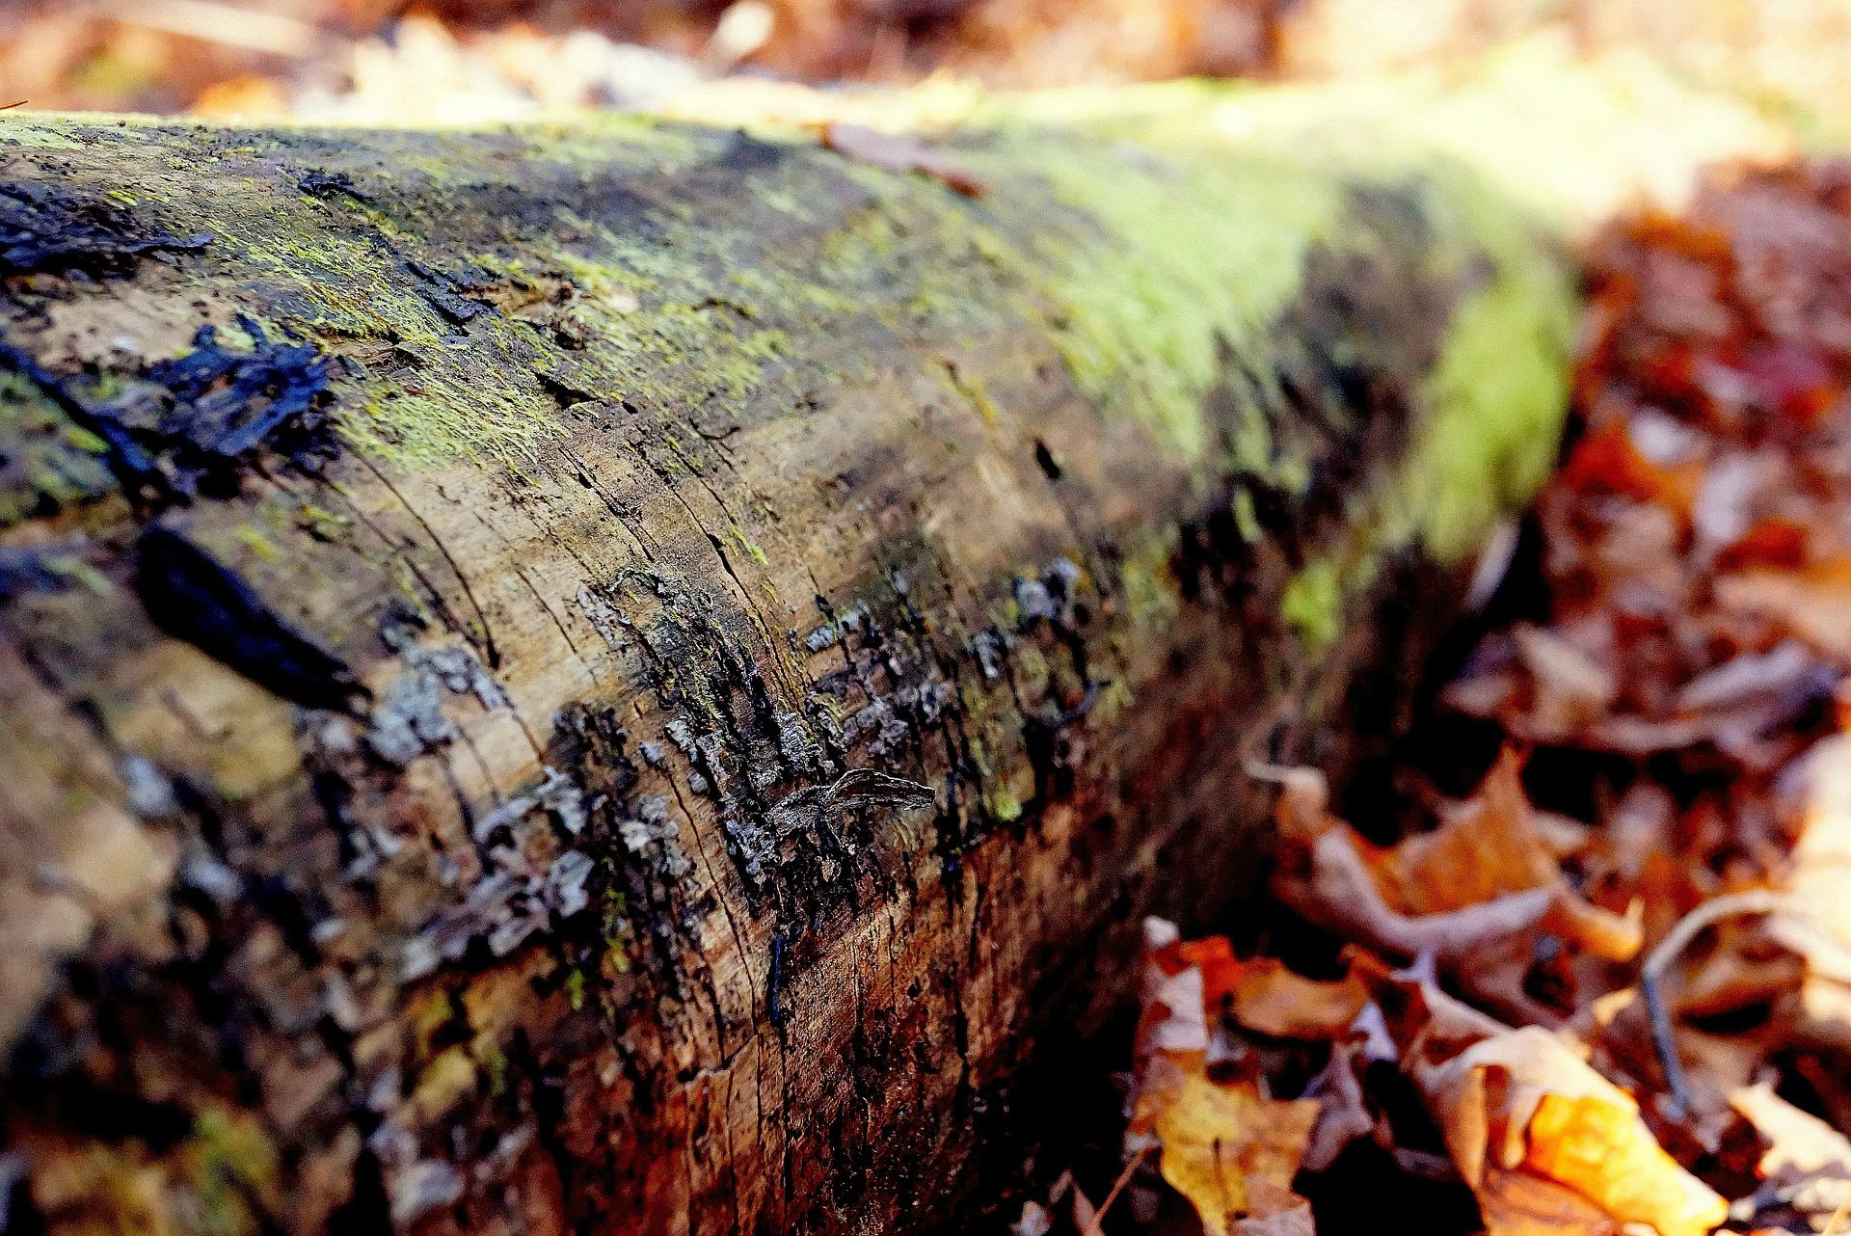
Oйн магадлан итгэмжлэлийн тухай
Mongolian forest Certification system
Монголын ойн тогтвортой менежментийн зөвлөл ТББ
Mongolian forest sustainable management NGO
Илтгэгч: Д.Мөнхзориг МОТМЗ ТББ
2018 ОНЫ 4 САРЫН 25
Мөрөн хот

Slide 2
Part 1 Олон улсын Магадлан итгэмжлэл
1
Ойн магадлал итгэмжлэл гэж юу вэ?
What is forest certification
2
Олон улсын ойн магадлан итгэмжлэлийн байгууллагууд
International forest certification organizations
CONTENT
3
О.М.И ямар ач тустай вэ?
Benefits of forest certification
Part 2 Магадлан итгэмжлэл Монгол улсад

Slide 3
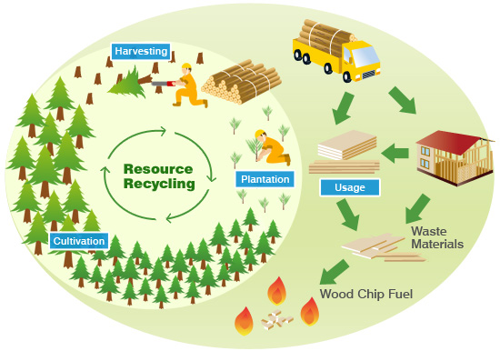
Oйн тогтвортой менежмент
Notes:
Forest certification is a mechanism for forest monitoring, tracing and labeling timber, wood and pulp products and non-timber forest products, where the quality of forest management is judged against a series of agreed standards. Credible forest certification covers much more than just logging practices – it also accounts for the social and economic well-being of workers and local communities, transparency and inclusiveness in decision making.
Forest certification is a relatively new development and relates not to the final product, but to the practice of forestry, including growth, harvesting, and ecological impacts associated with harvesting. Certified forests are managed in a sustainable manner and trees are harvested with environmentally sound practices. These management practices are certified by objective third parties. It is a voluntary, market-driven approach (as opposed to mandatory, regulatory approach) toward sustainable forest management. Forest Certification has as its goal that forests are to be managed sustainably. Sustainable forestry implies that the uses of the forest today will in no way hinder the uses of the forest tomorrow, with regard to biodiversity, productivity, and relevant economic and social functions.

Slide 4
Oйн магадлан итгэмжлэл гэж юу вэ?
Forest Certification
Дэлхий нийтийн туршлагаас харахад ойн тогтвортой менежментийг хамгийн үр дүнтэй хэрэгжүүлж байгаа хэлбэр бол ойн магадлан итгэмжлэлийн тогтолцоо юм. Олон улсын зах зээлийн чиг хандлага нь магадлан итгэмжлэгдсэн ойн сангаас гарсан мод, модон бүтээгдэхүүн, дагалт баялагийг худалдан авах эрмэлзлэлтэй байна.
Ойн магадлан итгэмжлэл гэдэг нь ойн тотгтвортой менежментэд түшиглэсэн, тодорхой шаардлага, стандартад нийцсэн ойн тандан судалгаа, мод модон бүтээгдэхүүн, ойн дагалт бүтээгдэхүүн зэргийг хамарсан ойг зүй зохистой ашиглах зорилготой механизм юм. /world wild life fund global.wwf/
Notes:
Forest certification is a mechanism for forest monitoring, tracing and labeling timber, wood and pulp products and non-timber forest products, where the quality of forest management is judged against a series of agreed standards. Credible forest certification covers much more than just logging practices – it also accounts for the social and economic well-being of workers and local communities, transparency and inclusiveness in decision making.
Forest certification is a relatively new development and relates not to the final product, but to the practice of forestry, including growth, harvesting, and ecological impacts associated with harvesting. Certified forests are managed in a sustainable manner and trees are harvested with environmentally sound practices. These management practices are certified by objective third parties. It is a voluntary, market-driven approach (as opposed to mandatory, regulatory approach) toward sustainable forest management. Forest Certification has as its goal that forests are to be managed sustainably. Sustainable forestry implies that the uses of the forest today will in no way hinder the uses of the forest tomorrow, with regard to biodiversity, productivity, and relevant economic and social functions.

Slide 5
Oйн магадлан итгэмжлэл гэж юу вэ?
Дараах үндсэн зарчмууд дээр cуурилсан байна.
Бие даасан засгийн газраас хараат бус ТББ.
Зөвхөн ойн ашиглалт талыг дэмжих бус нутгийн иргэд, ажил эрхэлж буй хүмүүс, эдийн засаг болон нийгэмд ээлтэй ил тод хүртээмжтэй шийдвэр гаргахад чиглэнэ.
Ойн холбогдох хууль тогтоомжид ,нийцсэн үйл ажиллгаа явуулна.
Ойн зэрлэг ан амьтан (Biodiversity) хамгаалах
Магадлан итгэмжлэлийн үр дүн шинжилгээ нь олон нийтэд ил тод байх
Тавигдах шалгуур, стандатыг хөгжүүлэхэд олон талын хүмүүс оролцох боломжтой
Шалгуур стандартын дагуу мод бэлтгэлийн аюулгүй байдлыг хангах
Notes:
Forest certification is a relatively new development and relates not to the final product, but to the practice of forestry, including growth, harvesting, and ecological impacts associated with harvesting. Certified forests are managed in a sustainable manner and trees are harvested with environmentally sound practices. These management practices are certified by objective third parties. It is a voluntary, market-driven approach (as opposed to mandatory, regulatory approach) toward sustainable forest management. Forest Certification has as its goal that forests are to be managed sustainably. Sustainable forestry implies that the uses of the forest today will in no way hinder the uses of the forest tomorrow, with regard to biodiversity, productivity, and relevant economic and social functions.

Slide 6
Олон улсын ойн магадлан итгэмжлэлийн байгууллага
International forest certification organizations
Notes:
FC is a set of standards that have been developed by organizations that indicate good management and a forest that’s well managed and those standards are in place landowners can do management on the property and conduct their business in a way that qualifies or meet those standers and they can be certified.

Slide 7
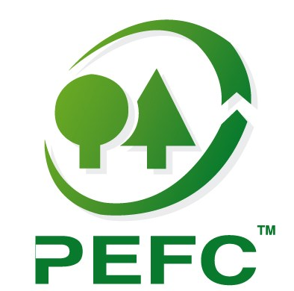
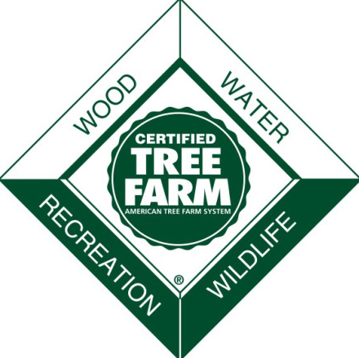
Forest stewardship council: 1993 байгуулагдсан. Oлон улсын ойн тогтвортой менежментийн үйл ажиллагаанд түшиглэсэн ойгоос гаралтай ба ойн бус бүтээгдэхүүнд стандарт тогтоож байгальд ээлтэй магадлан итгэмжлэл олгодог байгууллага юм. (fsc.org 2017)
Program for the Endorsement of Forest Certification : 1999 онд байгуулагдсан олон улсын ойн магадлан итгэмжлэлийн байгууллага. (pefc.org 2017)

Slide 8
PEFC

Slide 9
Магадлан итгэмжлэгдсэн ой
Certified Forest Area by Region
Нийт 35н улсын 300 гаруй сая га газрыг магадлан итгэмжлээд байна. http://pefc.org/resources/webinar/747-pefc-global-certification-forest-management-chain-of-custody
Source: www.pefc.org

Slide 10
О.М.И ямар ач тустай вэ
Benefits of forest certification
Үндсэн гурван төрлийн ашиг тустай
Эдийн засаг
Экологи
Нийгэм
Notes:
financial benefits
Price premiums for wood products originating from certified forests have long been a goal of forest certification. Yet such market differentiation has not yet produced price premiums on a large scale. Conventional thinking is that certified wood will receive the going market price, while wood that is not certified will receive a lower docked price. Heightened public awareness and/or growing demand for certified wood products, particularly if environmentally friendly green building initiatives increase, may affect long-term pricing for certified wood. Financial benefits, many superficial at present, can include:
1. Potential price premium; 2. Access to certified wood markets; 3. Access to developing ecosystem markets, such as carbon sequestration credits; 4. Interaction with professional foresters who can offer forest management recommendations; 5. Conserving or saving costs of forest ownership due to the lessening of burdensome regulation.
environmental benefits
The environmental benefits of forest certification can be more apparent than the financial benefits. Some research has shown that the environmental benefits of certification rank higher as reasons for certifying than the financial benefits. For instance, Alabama landowners claim improved wildlife habitat, enhanced timber productivity, and protection of the environment are the three most reasons for certifying their land. This was confirmed of Tennessee landowners, when they claimed having a healthier forest and improved wildlife habitat as the top reasons. Environmental benefits can include:
1. Improved forest management practices; 2. Improved wildlife habitat; 3. More healthy forests; 4. Protection of soil and water resources.
social benefits
Forest certification offers a number of benefits to the greater society in addition to those given above. Some of these benefits include: protection of cultural assets, protection of livelihood and the opportunity to demonstrate third-party verified sustainable forest management.

Slide 11
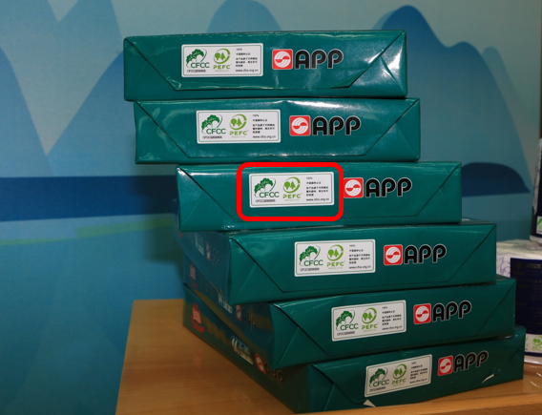
О.М.И ямар ач тустай вэ
Benefits of forest certification

Slide 12
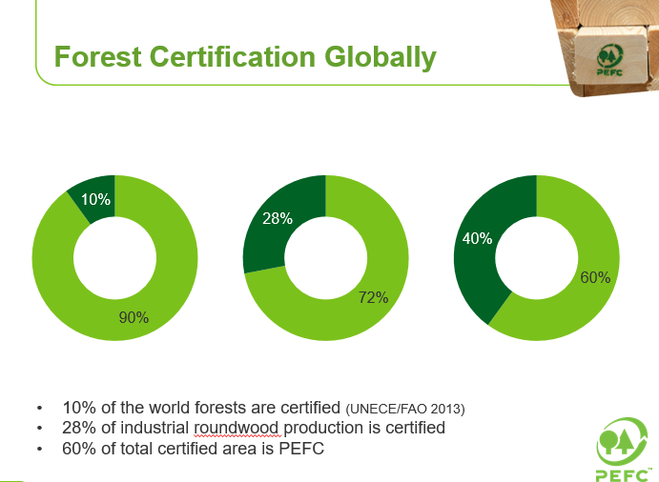

Slide 13
Магадлан итгэмжлэл Монгол улсад
Notes:
Forest certification is a mechanism for forest monitoring, tracing and labeling timber, wood and pulp products and non-timber forest products, where the quality of forest management is judged against a series of agreed standards. Credible forest certification covers much more than just logging practices – it also accounts for the social and economic well-being of workers and local communities, transparency and inclusiveness in decision making.
Forest certification is a relatively new development and relates not to the final product, but to the practice of forestry, including growth, harvesting, and ecological impacts associated with harvesting. Certified forests are managed in a sustainable manner and trees are harvested with environmentally sound practices. These management practices are certified by objective third parties. It is a voluntary, market-driven approach (as opposed to mandatory, regulatory approach) toward sustainable forest management. Forest Certification has as its goal that forests are to be managed sustainably. Sustainable forestry implies that the uses of the forest today will in no way hinder the uses of the forest tomorrow, with regard to biodiversity, productivity, and relevant economic and social functions.

Slide 14
Магадлан итгэмжлэлийн санаачлага, үйл явц
2013 он. ГОУХАН “Биологийн олон янз байдал ба ойн гол экосистемүүдийн уур амьсгалын өөрчлөлтөд дасан зохицох нь” хөтөлбөр II.
2015 оны 3 сар МОТМЗ ТББ байгуулагдсан.
2016 оны 3 сар Ойн магадлан итгэмжлэлийн стандарт, шалгуур үзүүлэлтийн төслийг Сэлэнгэ, Хөвсгөл, Булган аймгийн ААН-д туршилт хийв
2016 оны 9 сар. Магадлан итгэмжлэлийн шинжээчийн сургалт зохион байгуулав. Анхны 8 шинжээч
2016 оны 10 сар. Анхны 4 аж ахуйн нэгжид туршилтын магадлан итгэмжлэл хийгдэв.

Slide 15
Үндэсний ойн менежментийн стандарт нь: (PEFC)
Тухайн ойн экологи, төлөв байдал, практик үйл ажиллагаанд нийцсэн байх.
Тухайн улсын хууль эрх зүйн тогтолцоонд нийцсэн байх.
Ойн санг эзэмшигчидийн бүтэц, онцлогийг харгалзан үзсэн байх.
Орон нутгийн хэрэглээ болон хүлээлтийг харгалзан үзсэн байх.
Орон нутгийн ашиг сонирхол, эрх мэдэл, эзэмшилийн асуудлыг харгалзан үзсэн байх
Орон нутгийн оролцоо зэрэг асуудлыг багтаасан байна.
Notes:
Forest certification is a mechanism for forest monitoring, tracing and labeling timber, wood and pulp products and non-timber forest products, where the quality of forest management is judged against a series of agreed standards. Credible forest certification covers much more than just logging practices – it also accounts for the social and economic well-being of workers and local communities, transparency and inclusiveness in decision making.
Forest certification is a relatively new development and relates not to the final product, but to the practice of forestry, including growth, harvesting, and ecological impacts associated with harvesting. Certified forests are managed in a sustainable manner and trees are harvested with environmentally sound practices. These management practices are certified by objective third parties. It is a voluntary, market-driven approach (as opposed to mandatory, regulatory approach) toward sustainable forest management. Forest Certification has as its goal that forests are to be managed sustainably. Sustainable forestry implies that the uses of the forest today will in no way hinder the uses of the forest tomorrow, with regard to biodiversity, productivity, and relevant economic and social functions.

Slide 16
Олон улсын магадлан итгэмжлэлийн нийтлэг стандарт шаардлагууд (PEFC)
Шалгуур 1. Ойн нөөцийг хамгаалах, хадгалах, түүний дэлхийн нүүрстөрөгчийн эргэлтэнд оруулах хувь нэмэрийг дээшлүүлэх
Шалгуур 2.Ойн экосистемийн амьдрах чадвар, эрүүл байдлыг хадгалах
Шалгуур 3. Ойн бүтээмжит чанарыг сайжруулах, хадгалах (мод болон бусад)
Шалгуур 4.Ойн экосистемийн биологийн олон хэлбэрийг нэмэгдүүлэх, хадгалах, дэмжих
Шалгуур 5. Ойн хамгаалалтын үүргүүдийг хадгалах, сайжруулах (хөрс, ус г.м)
Шалгуур 6. Нийгэм, эдийн засгийн үүрэг, нөхцлийг дэмжих
Notes:
Forest certification is a mechanism for forest monitoring, tracing and labeling timber, wood and pulp products and non-timber forest products, where the quality of forest management is judged against a series of agreed standards. Credible forest certification covers much more than just logging practices – it also accounts for the social and economic well-being of workers and local communities, transparency and inclusiveness in decision making.
Forest certification is a relatively new development and relates not to the final product, but to the practice of forestry, including growth, harvesting, and ecological impacts associated with harvesting. Certified forests are managed in a sustainable manner and trees are harvested with environmentally sound practices. These management practices are certified by objective third parties. It is a voluntary, market-driven approach (as opposed to mandatory, regulatory approach) toward sustainable forest management. Forest Certification has as its goal that forests are to be managed sustainably. Sustainable forestry implies that the uses of the forest today will in no way hinder the uses of the forest tomorrow, with regard to biodiversity, productivity, and relevant economic and social functions.

Slide 17
Ойн бүтээмжит чанарыг сайжруулах, хадгалах (модлог болон бусад бүтээгдэхүүн)
Мод бэлтгэлийн ажлыг үр ашигтай, бүтээмжтэй явуулах. (бэлтгэсэн модны 90% доошгүй хувь ашигладдаг байх)
ААН талбайдаа модон түүхий эдийг зүсмэл ба зах зээлд эрэлт хэрэгцээтэй бүтээгдэхүүн болгох болон түлшний зориулалтаар бүрэн ашиглах. Модлог хаягдал үүсгэхгүй байх
Ойн бүтэц, таваарлаг чанарыг сайжруулахын тулд зөвхөн сонгож тэмдэглэсэн хөгшин модыг бэлтгэх ба энэ нь ойн доройтлоос сэргийлэх ба байгалийн нөхөн сэргэлтийг дэмжих ач холбогдолтой.
Notes:
Forest certification is a mechanism for forest monitoring, tracing and labeling timber, wood and pulp products and non-timber forest products, where the quality of forest management is judged against a series of agreed standards. Credible forest certification covers much more than just logging practices – it also accounts for the social and economic well-being of workers and local communities, transparency and inclusiveness in decision making.
Forest certification is a relatively new development and relates not to the final product, but to the practice of forestry, including growth, harvesting, and ecological impacts associated with harvesting. Certified forests are managed in a sustainable manner and trees are harvested with environmentally sound practices. These management practices are certified by objective third parties. It is a voluntary, market-driven approach (as opposed to mandatory, regulatory approach) toward sustainable forest management. Forest Certification has as its goal that forests are to be managed sustainably. Sustainable forestry implies that the uses of the forest today will in no way hinder the uses of the forest tomorrow, with regard to biodiversity, productivity, and relevant economic and social functions.

Slide 18
Ойн экосистем дэх биологийн олон янз байдлыг хамгаалах, хадгалах нэмэгдүүлэх
Хамгаалалтын бүсийн ойд үндсэн ашиглалт явуулахгүй байх.
Ойжуулалтийн болон ойн нөхөн сэргээлтийн үйл ажиллагаанд ойн үр тарьцын чанар ба байгалийн нөхцөлдөө тохирсон байх, генийн өөрчлөлтэй ба чанаргүй үр, тарьц хэрэглэхгүй байх
Ойжуулалтын үр дүн жилийн дараа багадаа 75 % нь амьдрах чадвартай байх
Байгалийн нөхөн сэргэлтийг дэмжих арга хэмжээг тэргүүн ээлжинд тавих
Notes:
Forest certification is a mechanism for forest monitoring, tracing and labeling timber, wood and pulp products and non-timber forest products, where the quality of forest management is judged against a series of agreed standards. Credible forest certification covers much more than just logging practices – it also accounts for the social and economic well-being of workers and local communities, transparency and inclusiveness in decision making.
Forest certification is a relatively new development and relates not to the final product, but to the practice of forestry, including growth, harvesting, and ecological impacts associated with harvesting. Certified forests are managed in a sustainable manner and trees are harvested with environmentally sound practices. These management practices are certified by objective third parties. It is a voluntary, market-driven approach (as opposed to mandatory, regulatory approach) toward sustainable forest management. Forest Certification has as its goal that forests are to be managed sustainably. Sustainable forestry implies that the uses of the forest today will in no way hinder the uses of the forest tomorrow, with regard to biodiversity, productivity, and relevant economic and social functions.

Slide 19
Ойн хамгаалалтын үүргүүдийг хадгалах, сайжруулах (хөрс, ус)
Ойн менежментийн хүрээнд гадаргын ба гүний усны бохирдол үүсгэхгүй байх. Гол мөрний эх, сав газрууд ба намгархаг бүсүүдэд ямар нэг сөрөг нөлөөлөл үзүүлэхээс урьдчилан сэргийлэх.
Мод бэлтгэлийн талбай бэлтгэх, зам гаргах үйл ажиллагааны үед ойн хөрсний элэгдэл эвдрэл, доройтлыг үүсгэхгүй байх. Үүнд түймрээс хамгаалах зурвас хамаарахгүй.
Бүх төрлийн хог хаягдалыг ойн талбайгаас гаргаж зохих журмын дагуу зайлуулах. Асгарсан түлш, тос тосолгооны материал, машин техникийн шингэнийг хоргүйжүүлэх, саармагжуулах, шингээх материал хэрэгслийг бүх машин техникт бэлэн байлгах
Notes:
Forest certification is a mechanism for forest monitoring, tracing and labeling timber, wood and pulp products and non-timber forest products, where the quality of forest management is judged against a series of agreed standards. Credible forest certification covers much more than just logging practices – it also accounts for the social and economic well-being of workers and local communities, transparency and inclusiveness in decision making.
Forest certification is a relatively new development and relates not to the final product, but to the practice of forestry, including growth, harvesting, and ecological impacts associated with harvesting. Certified forests are managed in a sustainable manner and trees are harvested with environmentally sound practices. These management practices are certified by objective third parties. It is a voluntary, market-driven approach (as opposed to mandatory, regulatory approach) toward sustainable forest management. Forest Certification has as its goal that forests are to be managed sustainably. Sustainable forestry implies that the uses of the forest today will in no way hinder the uses of the forest tomorrow, with regard to biodiversity, productivity, and relevant economic and social functions.

Slide 20
Бусад нийгэм эдийн засгийн үүрэг, нөхцөл байдлыг харгалзах
ОМБ-ууд зөвхөн зохих сургалтанд сууж мэргэшсэн ажилчинд ажил олгоно. Мэргэжлийн ажилчин гэж 2 жилийн ойн мэргэжлийн боловсролтой, олон жилийн ажлын туршлагатай эсвэл хамгийн багадаа 1 долоо хоногын сургалт авсан хүнийг хэлнэ. Хэрэв 1 долоо хоногын моторт хөрөөний сургалт авсан бол сүүлийн 5 жилийн дотор байх ёстой. ААН нь магадлан итгэмжлэлэнд хамрагдсан тохиолдолд 2 жилийн дотор бүх ажилчид нь дээрх шаардлагыг хангах. Туслах гэрээгээр ажил гүйцэтгэж байгаа ААН-д дээрх шаардлагууд мөн хүчинтэй
ОМБ хосмог мэргэжлийн боловсрол сургалтын багш ажилчинтай байх ба МСҮТ-тэй хамтран ойн мэргэжлийн ажилчин бэлтгэнэ
ОМБ-н моторт хөрөөтэй ажиллах ажилчид зохих ХАБ, осол, гэмтлээс хамгаалах НБХХ хэрэглэдэг байх. Бусад ойд ажиллагсад ХАБ хангах хувцас хэрэгсэл дуулга гутал хэрэглэж хэвшсэн байх.
Notes:
Forest certification is a mechanism for forest monitoring, tracing and labeling timber, wood and pulp products and non-timber forest products, where the quality of forest management is judged against a series of agreed standards. Credible forest certification covers much more than just logging practices – it also accounts for the social and economic well-being of workers and local communities, transparency and inclusiveness in decision making.
Forest certification is a relatively new development and relates not to the final product, but to the practice of forestry, including growth, harvesting, and ecological impacts associated with harvesting. Certified forests are managed in a sustainable manner and trees are harvested with environmentally sound practices. These management practices are certified by objective third parties. It is a voluntary, market-driven approach (as opposed to mandatory, regulatory approach) toward sustainable forest management. Forest Certification has as its goal that forests are to be managed sustainably. Sustainable forestry implies that the uses of the forest today will in no way hinder the uses of the forest tomorrow, with regard to biodiversity, productivity, and relevant economic and social functions.

Slide 21
ОМБ-ыг магадлан итгэмжлэх шалгуур үзүүлэлтүүд
Энэхүү магадлан итгэмжлэлийн концепцийг нэврүүлэх жишиг нь Монгол улсад олон улсад хүлээн зөвшөөрөгдөх ойн тогтвортой менежментийн магадлан итгэмжлэлийн системийг нэвтрүүлэх томоохон ажлын суурь болох юм.
Эдгээр зорилтын үр дүнд Ойд үйлдвэрлэлийн зориулалтаар мод бэлтгэх ба Ойн арчилгаа, цэвэрлэгээний ажил гүйцэтгэх мэргэжлийн байгууллагын үйл ажиллагаанд магадлан итгэмжлэл хийх, үнэлгээ өгөх шалгуур үзүүлэлтийг боловсруулсан.
Notes:
Forest certification is a mechanism for forest monitoring, tracing and labeling timber, wood and pulp products and non-timber forest products, where the quality of forest management is judged against a series of agreed standards. Credible forest certification covers much more than just logging practices – it also accounts for the social and economic well-being of workers and local communities, transparency and inclusiveness in decision making.
Forest certification is a relatively new development and relates not to the final product, but to the practice of forestry, including growth, harvesting, and ecological impacts associated with harvesting. Certified forests are managed in a sustainable manner and trees are harvested with environmentally sound practices. These management practices are certified by objective third parties. It is a voluntary, market-driven approach (as opposed to mandatory, regulatory approach) toward sustainable forest management. Forest Certification has as its goal that forests are to be managed sustainably. Sustainable forestry implies that the uses of the forest today will in no way hinder the uses of the forest tomorrow, with regard to biodiversity, productivity, and relevant economic and social functions.

Slide 22
“Ойд үйлдвэрлэлийн ашиглалт” ба “Ойн арчилгаа, цэвэрлэгээний үйл ажиллагаа" эрхэлдэг аж ахуйн нэгж, байгууллагын үйл ажиллагаанд магадлан итгэмжлэл хийх шалгуур үзүүлэлтүүд
No. | Чиглэл |  | Шалгуур үзүүлэлт | Тайлбар | Дүгнэх оноо
 |  |  |  |  | нийт | хувь | дүн | минимум
1. | Хүний нөөц | 1.1 | Захиралын боловсрол | Дээд мэргэжилийн диплом | 1 | тийм, үгүй (1/0)
 |  | 1.2 | Ажилчид албан хаагчдийн боловсрол | Мод бэлтгэлийн үйл ажиллагаа хариуцсан нэгжийн дарга нь ойн инженер, техникч мэргэжилтэй /бэлтгэлийн талбайд/ | 6 | (1 - 6) |  | 4
 |  | 1.3 | Мод бэлтгэгч нарын мэргэжлийн боловсрол | Багадаа 2 долоо хоногын курс, хөрөөчин, цагаалагч гэх мэт /багадаа 25%/ | 4 | 25/50/75/100% (1 - 4) |  | 2
 |  | 1.4 | Мод бэлтгэлийн байнгын бригадтай эсэх | Бригадын ажилчид тогтвортой ажилдаг | 4 | 25/50/75/100% (1 - 4) |  | 2
 |  | 1.5 | Ажилчидын давтан сургалт | Ажилчид жилд 3-аас доошгүй өдөр давтан сургалтад хамрагддаг | 2 | 0/50/100% (1-2) |  | 1
 | Нийт |  |  |  | 17 |  |  | 9
Notes:
Энэхүү магадлан итгэмжлэлийн концепцийг нэврүүлэх жишиг нь Монгол улсад олон улсад хүлээн зөвшөөрөгдөх ойн тогтвортой менежментийн магадлан итгэмжлэлийн системийг нэвтрүүлэх томоохон ажлын суурь болох юм.
Эдгээр зорилтын үр дүнд Ойд үйлдвэрлэлийн зориулалтаар мод бэлтгэх ба Ойн арчилгаа, цэвэрлэгээний ажил гүйцэтгэх мэргэжлийн байгууллагын үйл ажиллагаанд магадлан итгэмжлэл хийх, үнэлгээ өгөх шалгуур үзүүлэлтийг боловсруулсан.

Slide 23
Магадлан итгэмжлэгдсэн аж ахуйн нэгжид үзүүлэх хөнгөлөлт, урамшуулалын санал боловсруулах
Магадлан итгэмжлэгдсэн ААН-д үзүүлэх хөнгөлөлт, урамшуулалын саналыг үндсэн 5 чиглэлээр боловсруулсан.
Банк, санхүү хөрөнгө оруулалт
Гааль татварын хөнгөлөлт
Ойн менежмент, төлөвлөлт
Үйлдвэрлэл
Сургалт, сурталчилгаа

Slide 24
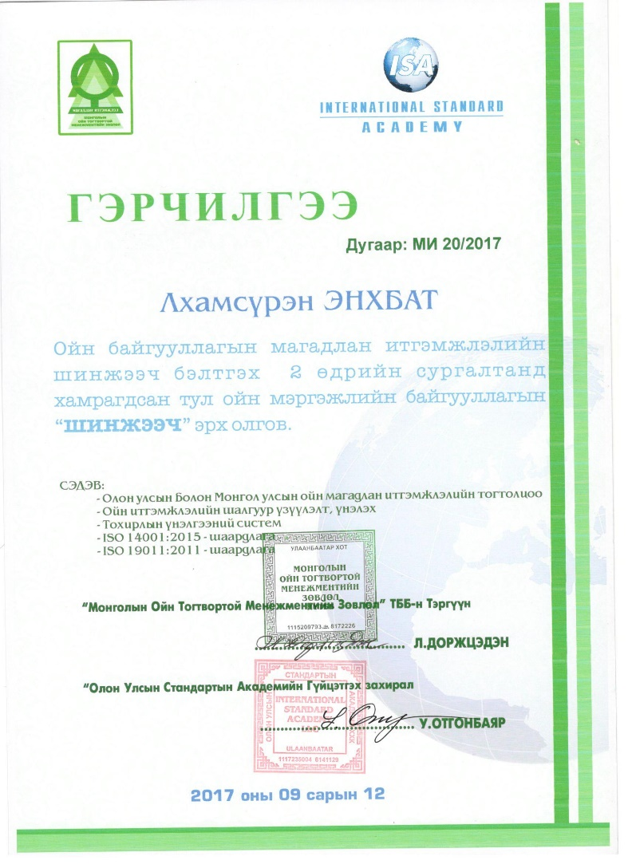
Магадлан итгэмжлэлийн шинжээчийг бэлтгэх
Магадлан итгэмжлэл хийх шинжээчийг бэлтгэх сургалтыг зохион байгуулж 8 хүнд шинжээчийн түр эрх олгосон.
Шинжээчийн баримтлах ёс зүй, үнэлэх арга зүй, магадлан итгэмжлэлд шаардлагатай баримт бичгүүд, тайлангийн загвар, зөвлөмж, зөвлөмжийг хэрэгжүүлэх төлөвлөгөө

Slide 25
Магадлан итгэмжлэл
2016-2017 онуудад Сэлэнгэ аймгиийн Алтанбулаг, Сүхбаатар, Хүдэр, Ерөө, Мандал сумдын нийт 10 ойн мэргэжлийн байгууллага итгэмжлэл авсан.

Slide 26
Promote the sustainable forest management
Web site: www.forest.mn. 70009501, 88119501
Email: munkhzorig@forest.mn , Bilguutei@forest.mn

Slide 27
Reference
http://pefc.org/resources/webinar/747-pefc-global-certification-forest-management-chain-of-custody
http://forestandrange.org/Forest%20Certifi
http://wwf.panda.org/about_our_earth/deforestation/forest_sector_transformation/forest_certification/cation/benefits.html
Developing a national forest certification system, 2014
https://en.wikipedia.org/wiki/Programme_for_the_Endorsement_of_Forest_Certification
https://www.pefc.org/
http://fsc.org/

